Slide 1
Fraud Management
Business Scenarios Special Presentation: Mitigations from a provider perspective

Slide 2
Agenda
Introductions
Goals & Objectives
Scope & Approach
Deliverables / Outputs
Teams, Roles & Responsibilities
Current Status & Next Steps
Special Presentation: Mitigations from a provider perspective

Slide 3
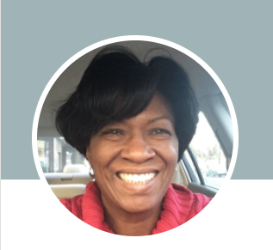
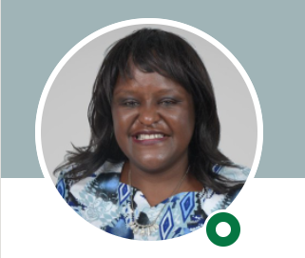
Introduction
Business Scenarios Project Management
Charity Elkins, MBA
Regional Director, Crosslake Technology
Special Presentation: Mitigations from a provider perspective
Mercy W Buku LLM (UOL), CAMS, ACIB (UK)
Anti Money Laundering and CFT Practitioner and Consultant Digital Financial Services

Slide 4
Project Goals and Objectives
Bring together recommended partners to develop a cohesive business requirements best-in-class fraud management.
Develop primary and secondary fraud use cases and typologies that impact the poor.
Create a collaborative view on how to reduce real-time payment fraud in developing countries.
Make available as a public good and may inform the development of solutions by participants in the group, or external parties.

Slide 5
Scope and Approach
Sub-Saharan geographies
e-money providers
Local and regional banks as users of fraud management tools
High-level use cases
Transaction fraud (e.g., stolen credentials, fraudulent transactions)
Third-party fraud
Social engineering fraud

Slide 6
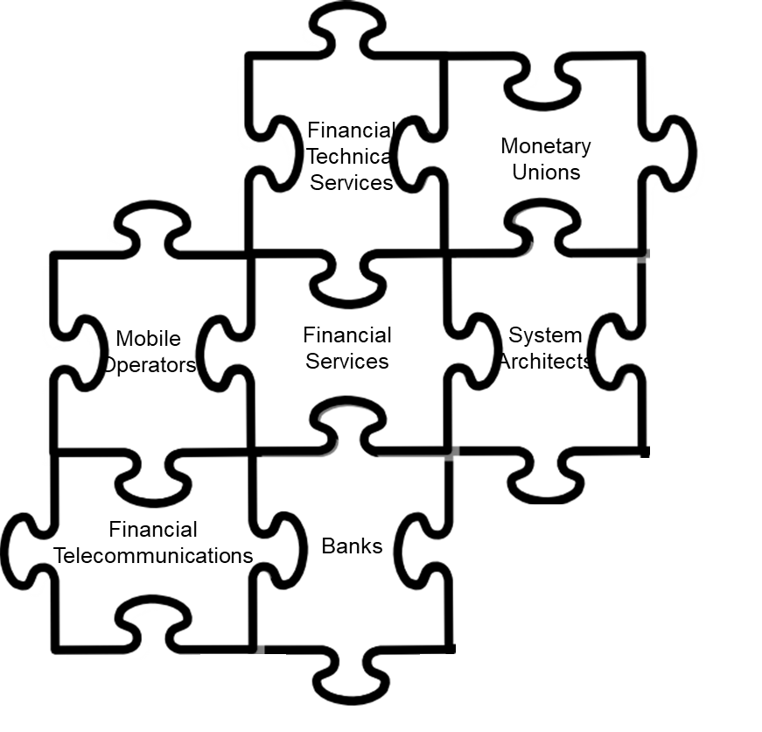
Current Partnerships Industries and Companies
Working group members include real-time schemes, banks, e-money issuers, and fraud software providers.
BankservAfrica - Largest automated clearing house in Africa.
JoPACC – The Jordan Payments and Clearing Company develops and enhances digital retail and micropayment systems.
Montran - Comprehensive platform-independent payment, clearing, and settlement solutions platform-independent.
Sybrin - Provides a framework for rapid digital transformation.
Individual industry consultants provide oversight and governance.
Notes:
Largely non-technical
CMA – Monetary Union
BankservAfrica - is the largest automated clearing house in Africa. We build and operate South Africa's core interbank payments infrastructure. Payments AND transactions are our lifeblood and we understand the need for modernisation in the payments landscape.
MC – Financial Services, American multinational financial services corporation
Vocal Link - a masterard company,
UPI from India - Financial Telecommunicaitons
Montran - financial services

Slide 7
Project Management Approach
Core Team
Workstreams
Integration
Governance Body
Working Body
Merge Workstream Deliverables
Teams, Roles, and Responsibilities
Core
Workstreams
Governance / Oversight
Industry Expertise Sharing
Workstream Check-Ins
Weekly / Bi-Weekly
Training / Status/ Help Wanted
Workstream Deliverables and Report Outs Cadence
Workstream Integration
Business Requirement Delivery
1HCY22

Slide 8

Deliverables and Outputs
High Level Requirements
Defined High Level Requirements
Identified Personas
Persona Definition
Defined Personas
Defined Use Cases
Prioritized list of User Cases
Opportunity / Gap Definition
Completed Journey Maps
Determine gaps and opportunities in FRAUD system
Data inputs and outputs
Defined dependencies
Develop initial set driving standards / regulations requirements
Business Requirements
Workstream Requirements
Definitions Documents
White Papers as appropriate
Identified Dependencies
Risk and Open Items Register
Consolidated Requirements
Workstream Definition
Owners Identified
S.M.A.R.T. Objectives Identified
Deliverables Defined
Timelines Defined

Slide 9
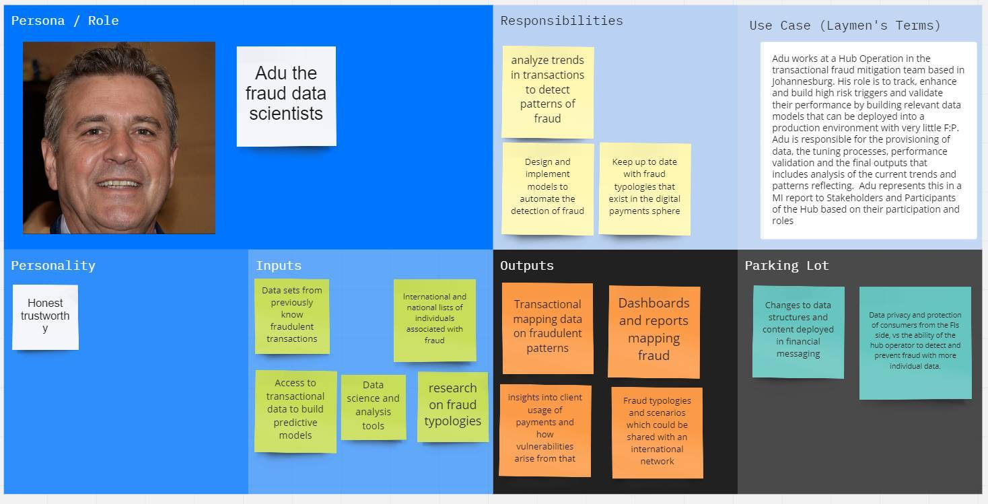
Persona Examples

Slide 10
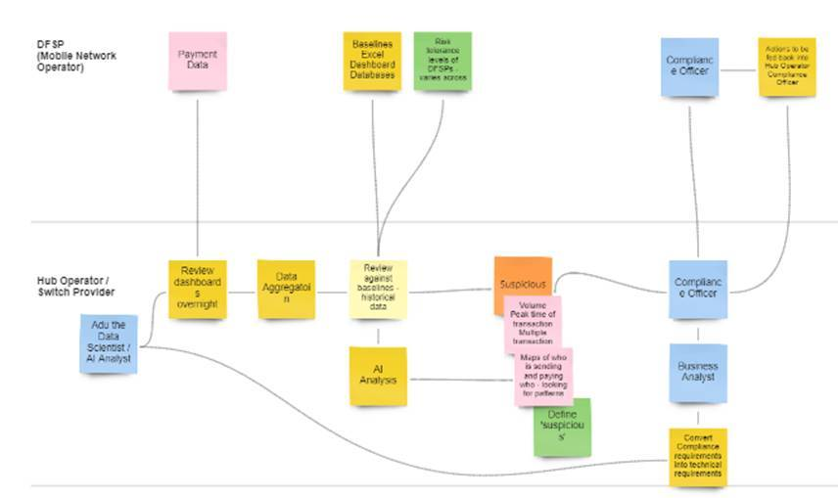
Journey Map Example
Focus on the User
Persona Swim Lanes
Processes
Data Inputs / Outputs
Key Dependencies
Gaps Identification

Slide 11
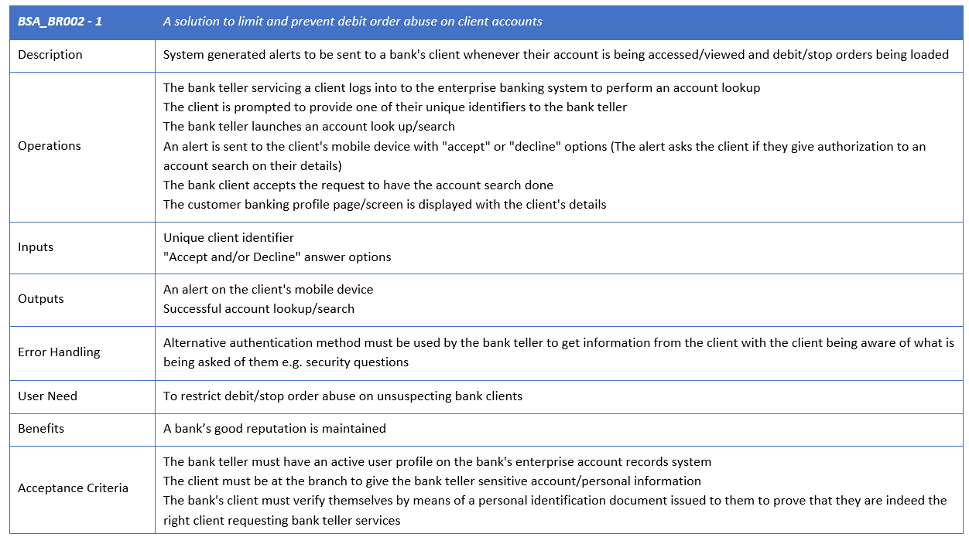
Business Requirements Example
Mapped to Journey Maps
Business Requirements
Description
Operations
Inputs/Outputs
Error Handling
User Needs
Acceptance Criteria
Test Approach

Slide 12
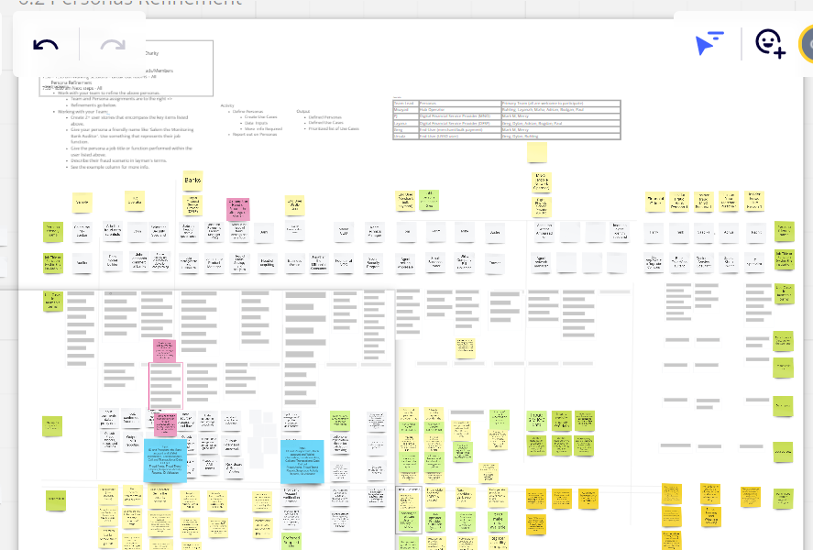
Collaboration Tools
Miro Fraud Workspace
Enables remote team collaboration.
Mirrors working in a conference room with whiteboards.
Sticky Notes
Synchronous and asynchronous work
Single system of record
Infinite whiteboard
Zoom
Enables break out rooms for sub-team collaboration

Slide 13
Status By Workstream Target completion 6/2022
Workstream | Workstream Owner | BA Resource | Persona Cards | Journey Maps | Bus. Req. % Complete | Comment
Financial Crime | BankservAfrica | Ursula Pearson Selby Gumbi |  | ✓ | 80%
Hub Operator | JoPACC | Layanah Wreikat Moayad Ghannam | ✓ | ✓ | 40%
End-User | BankservAfrica | Ursula Pearson Selby Gumbi | ✓ | ✓ | 0% | Will begin once Financial Crime nears completion.
Central Bank | Montran | Adrian Carcu | ✓ | ✓ | 45%
DFSP Banks | Sybrin | Greg McCormick Arthur Munjeri | ✓ | ✓ | 20%
Notes:
Ursula Pearson-Williams - Senior Manager Transactional Fraud Mitigation Services at BankservAfrica
Mercy Buku - Anti Money Laundering and CFT Practitioner and Consultant Digital Financial Services
Layanah Wreikat - Business Development Manager
Moayad Ghanna - Business Innovation and Analytics Specialist
Adrian Carcu - Chief Software Architect / Product Manager for Payment Hubs & Gateways, Virtual Account Management, Liquidity Management, Fraud Management, AML, Sanctions Scanning
Greg McCormick - Chief Strategic Business Development Officer
21 Persona Cards
10 Financial Crime
5 Hub Operator
4 Central Bank
4 DFSP Banks

Slide 14

Next Steps
Continue working on Business Requirements
Report out to Governance team
Possible Collaborative FTF Meeting in Q22022.
Notes:
Bas identified for some teams.

Slide 15
Next Up
Mitigations from a provider perspective
Presented By:
Mercy W Buku LLM (UOL), CAMS, ACIB (UK)
Legal and Risk Management Consultant
Digital Financial Services

